Slide 1



Why Do Programmers Do What They Do?
A Theory of Influences on Security Practices
Lavanya Sajwan
Supervisors: James Noble, Craig Anslow

Slide 2

The Problem
Lack of Qualitiative Research
Programmers Blamed
Lack of Understanding

Slide 3


What is Security?
CONFIDENTIALITY
INTEGRITY
AVAILABILITY

Slide 4
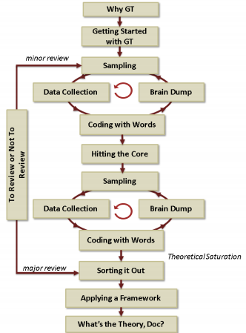


Methodology
Grounded Theory

Slide 5



Methodology
Recruitment and Collection

Slide 6
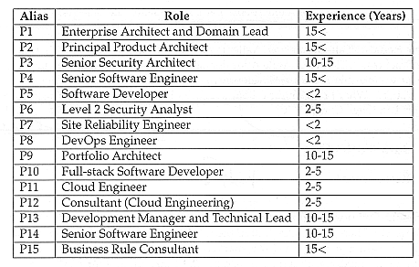
Methodology
Participant Summaries

Slide 7
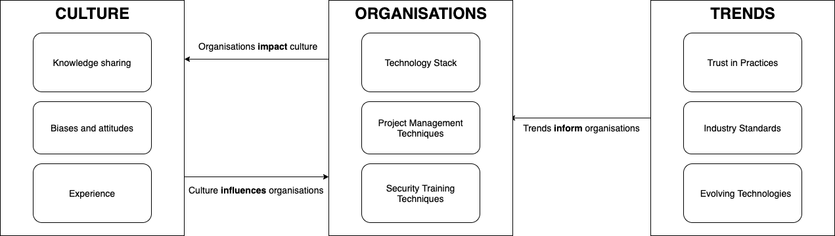
The Emergent Theory

Slide 8

The Emergent Theory

Slide 9

The Emergent Theory

Slide 10
The Emergent Theory

Slide 11
The Emergent Theory
The Relationships Between Categories
Trends inform Organisations
Organisations impact Culture
Culture influence Organisations

Slide 12


Evaluation
Chosen Methodology
Ethnography
Phenomenology

Slide 13

Evaluation
internal Methodology Processes
Recruitment
Data Collection

Slide 14

FIT
WORK
01
02
"Fit refers to the emergence of conceptual codes and categories from the data rather than the use of preconceived codes or categories from extant theory"
"Work refers to the ability of the grounded theory to explain and interpret behaviour in a substantive area and to predict future behaviour."
RELEVANCE
MODIFIABILITY
"Relevance refers to the theory’s focus on a core concern or process that emerges in a substantive area. Its conceptual grounding in the data indicates the significance and relevance of this core concern or process thereby ensuring its relevance."
03
"Modifiability refers to the theory’s ability to be continually modified as new data emerge to produce new categories, properties or dimensions of the theory. This living quality of grounded theory ensures its continuing relevance and value to the social world from which it has emerged."
04

Slide 15
Implications for Practice
Coporate Hackathons
Active Technical Training
Explicitly define project managment methodologies

Slide 16


Limitations and Future Work
Gender imbalance
NDA's
Narrowing scope
A study on corporate Hackathons

Slide 17
Security is growing space and support for programmers needs to match this

Slide 18


Thank You!
Questions?
Lavanya Sajwan
sajwanlava@myvuw.ac.nz
Supervisors:
James Noble, Craig Anslow

